Slide 1
LIFE AT MARITIME
A Project By
Miraç Sarmusak
Borahan Alpaslan

Slide 2
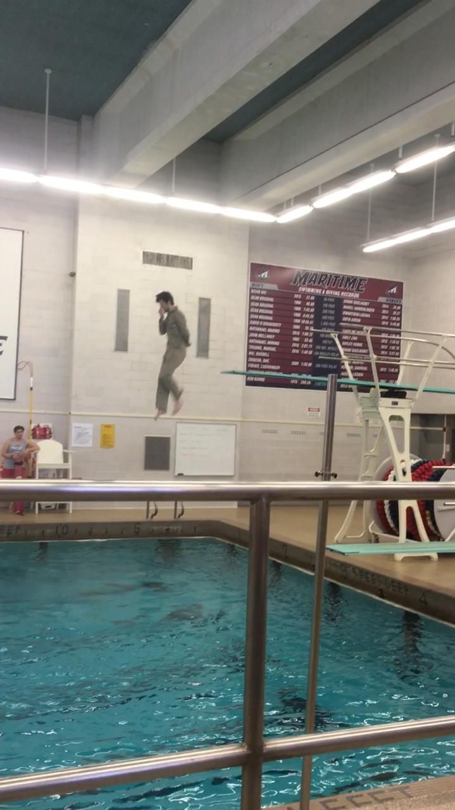
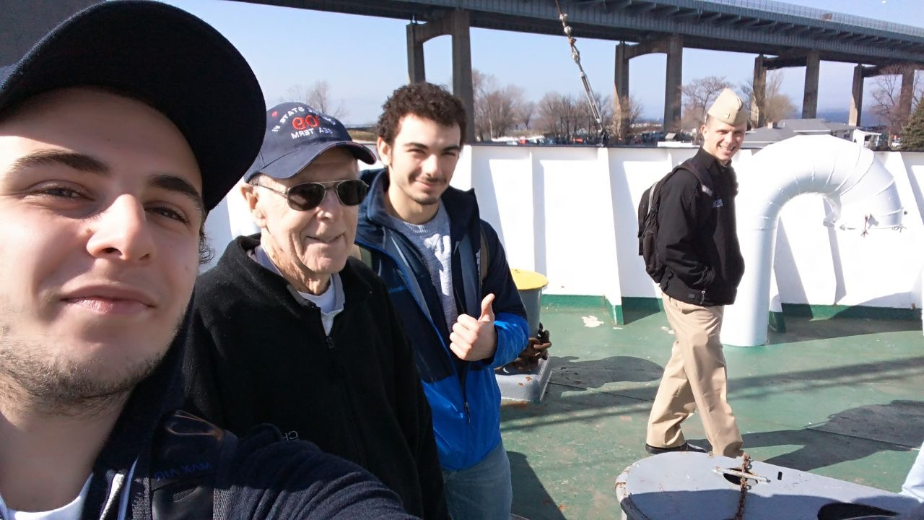
ACADEMIC LIFE
Teachers are strict, they want you to be punctual. But they are also kind. They will help you with any problem you have.
Quizzes and homeworks are as important as exams.
But most of the time you are going to have fun especially with Cpt. Stephens.
By the way if you are afraid of heights, you are really going to have a bad time in survival training.

Slide 3
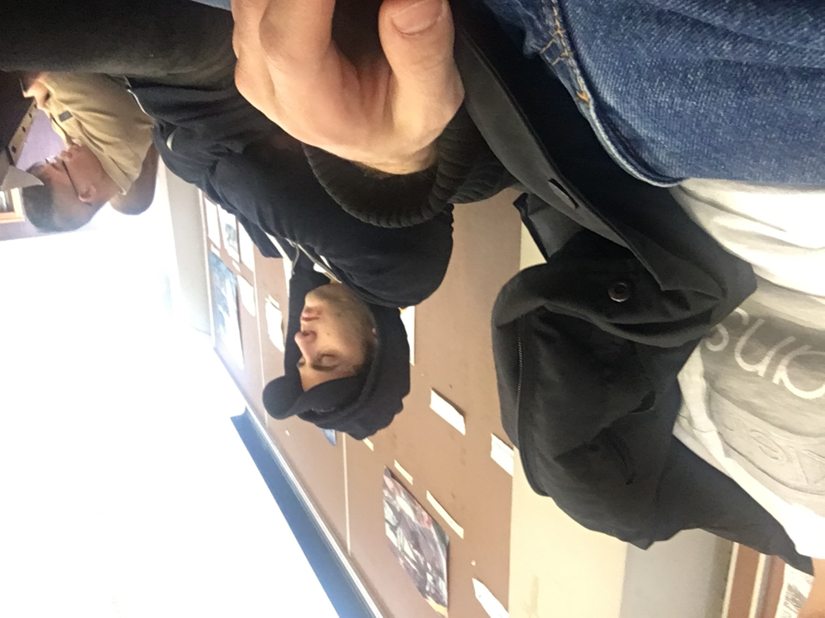
You must attend classes.
Especially the STCW ones, you will mostly be allowed to miss two classes.
If you miss more than two you will fail.
And don’t sleep to much.

Slide 4
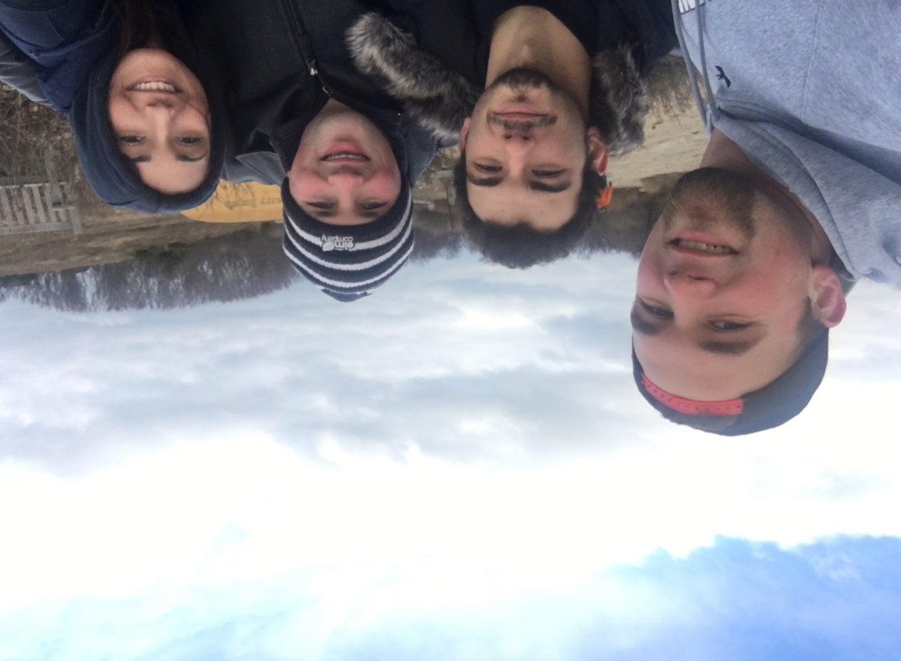
DORM LIFE
Civillian dorms are comfortable and clean. Bathroom and room cleanings are done by the students. I hope you guys will have nice roommates , it is crucial. It will affect your life at Maritime. Talk and try to hangout with them, it is best way to see New York.

Slide 5
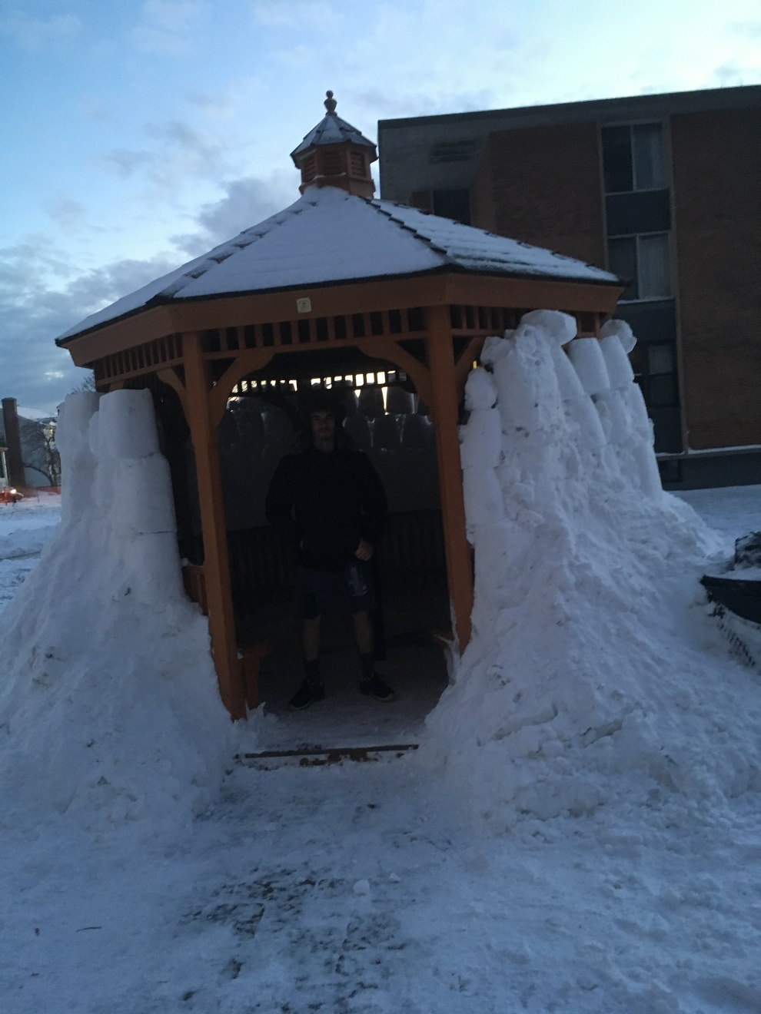
However, New York has a different weather. One day it is 10 Celcius and the next day it is -5. Be careful don’t get cold.
By the way this is Gazebo, you can only smoke inside these.

Slide 6
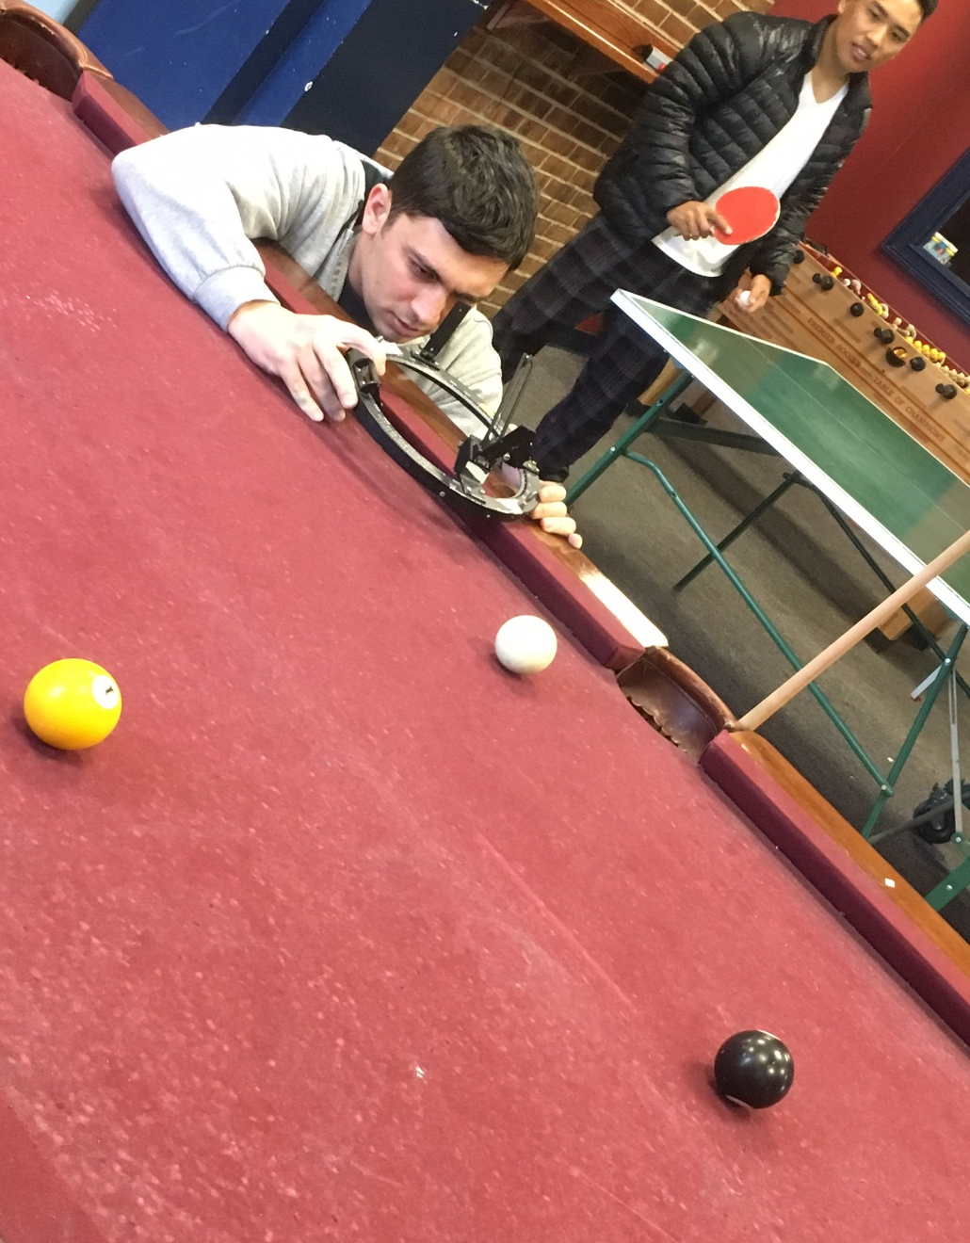
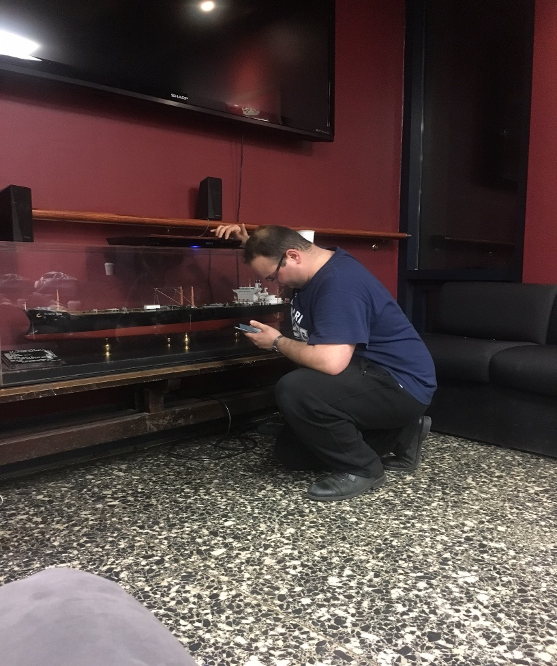
ACTIVITIES AND FUN
The Gameroom is a place in which you can sit and relax, play billards, table tennis, ps4, xbox and many more table top games.
Play it like your life depends on it. If you lose the game , you lose the table.
Never forget connecting to the bluetooth in the gameroom.

Slide 7
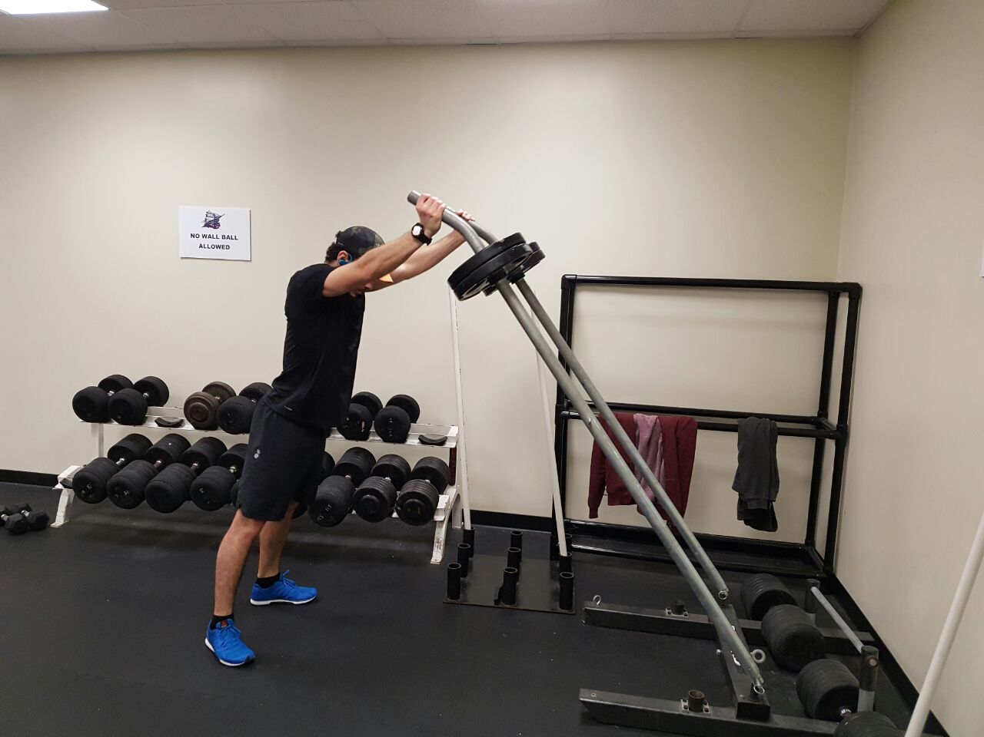
ACTIVITIES AND FUN
The gym here is well equipped.
They have a huge grass field.
You can join clubs or teams.

Slide 8
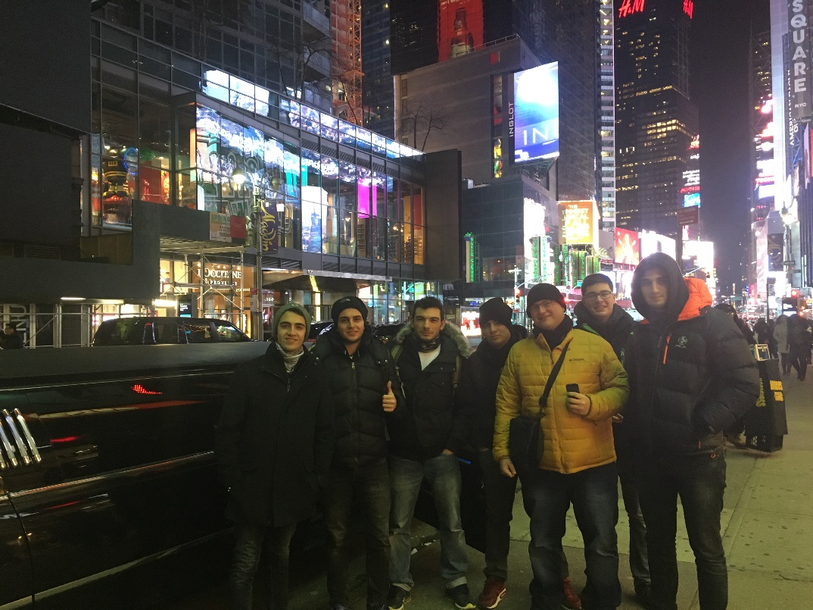
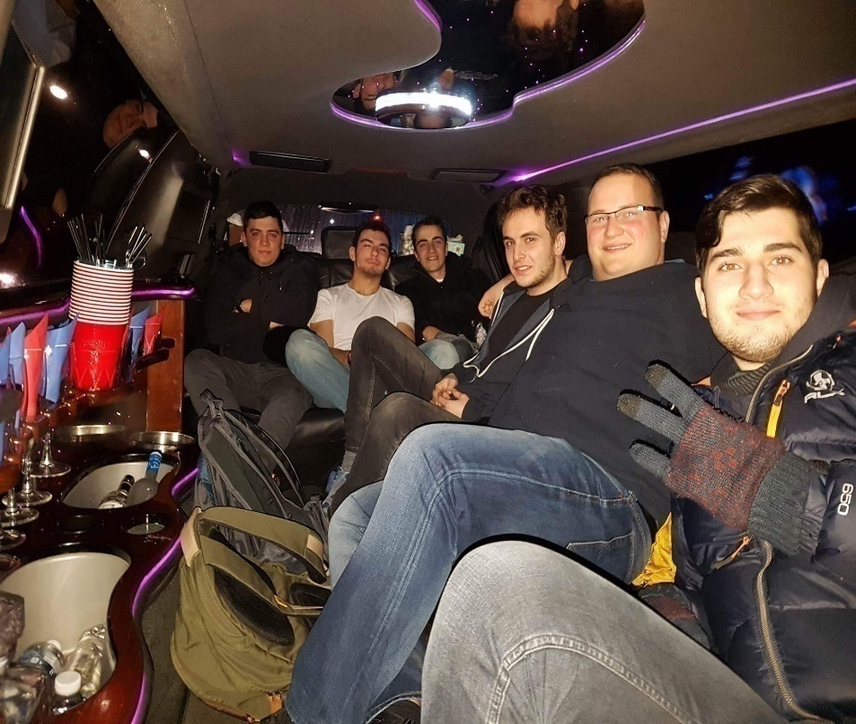
Manhattan
City is also beautiful. It takes two hours of bus and train ride but it is worth the time. You can find anything you need in the city. It has all kinds of activities for all kinds of people.
There are so many stuff to do in Manhattan, Broadway shows, bars , restaurants and you can even get a limousine ride.

Slide 9
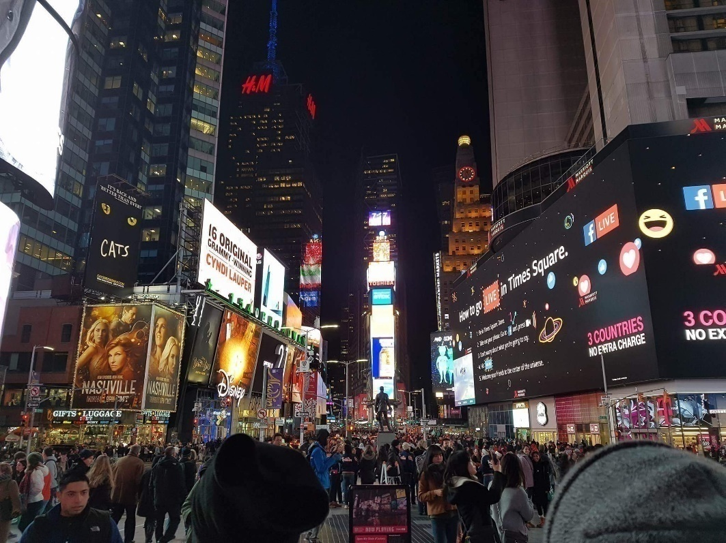

Slide 10
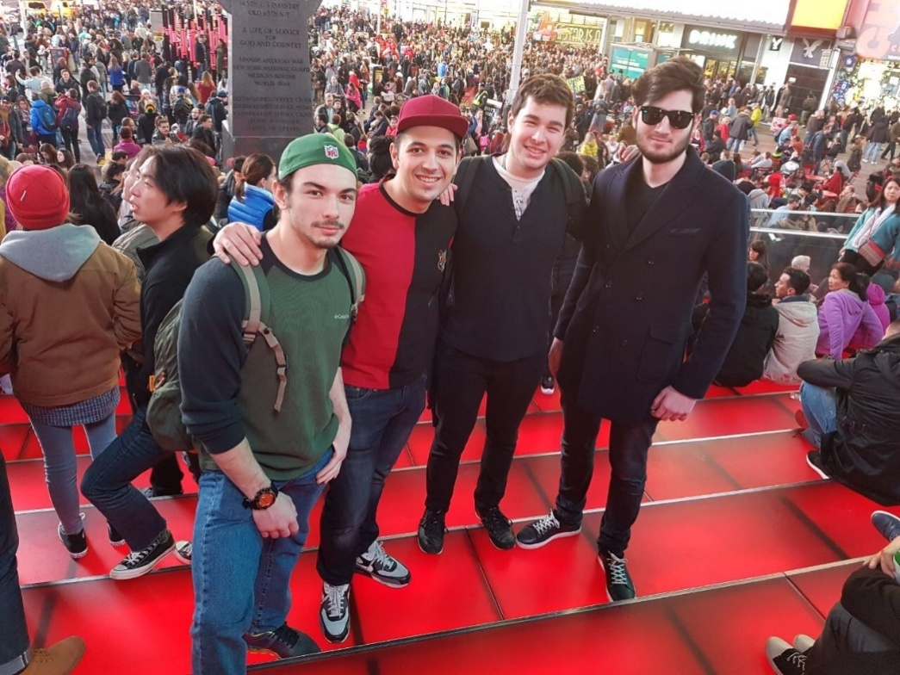

Slide 11

If you enjoy reading comics, manga or if you just enjoy looking at colour full books and t-shirts this place will be your own heaven.

Slide 12
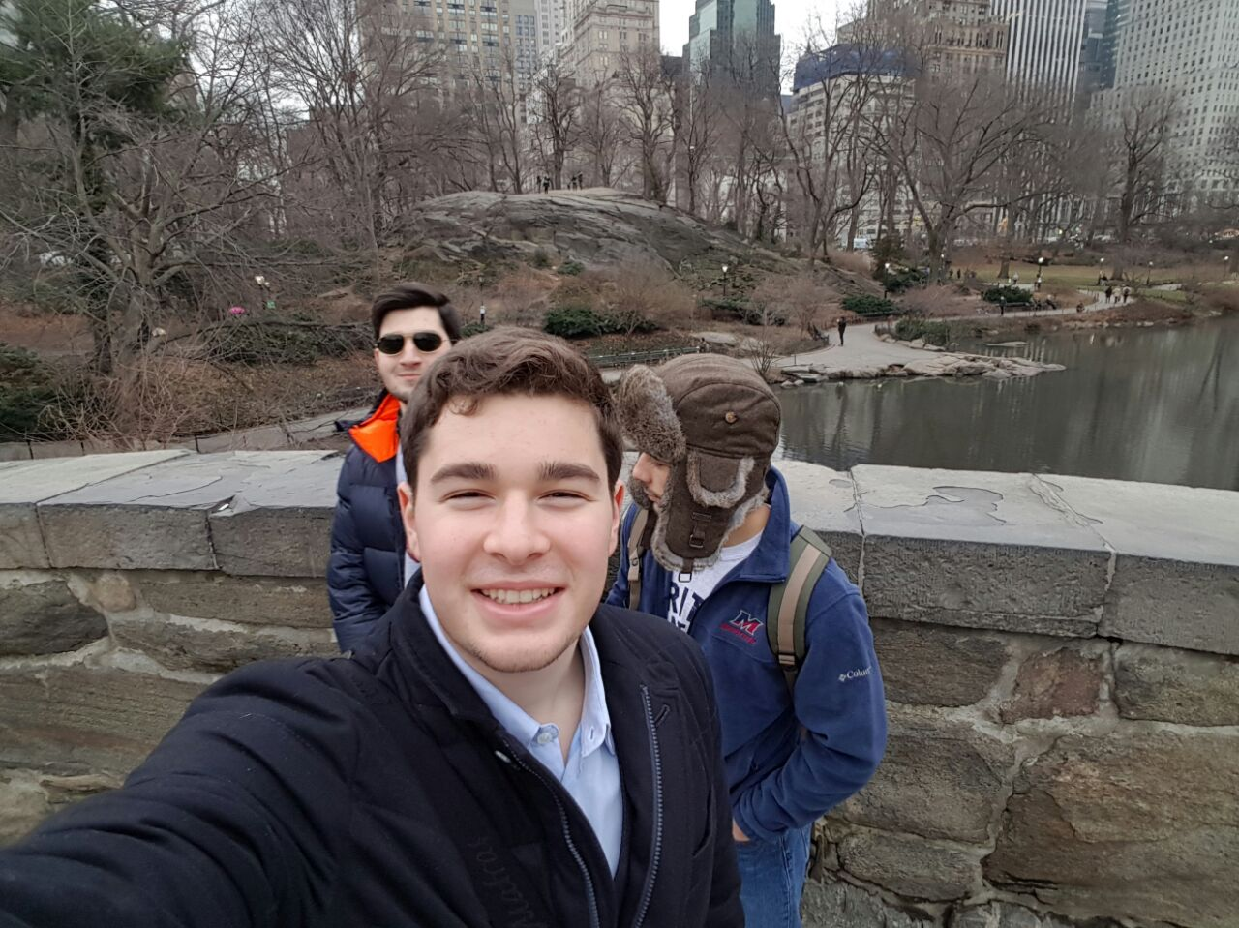
In Central Park you can take great scenery photos
It has the clearest air in the city aside from the botanic garden.
Jogging there is quite fun aswell.

Slide 13
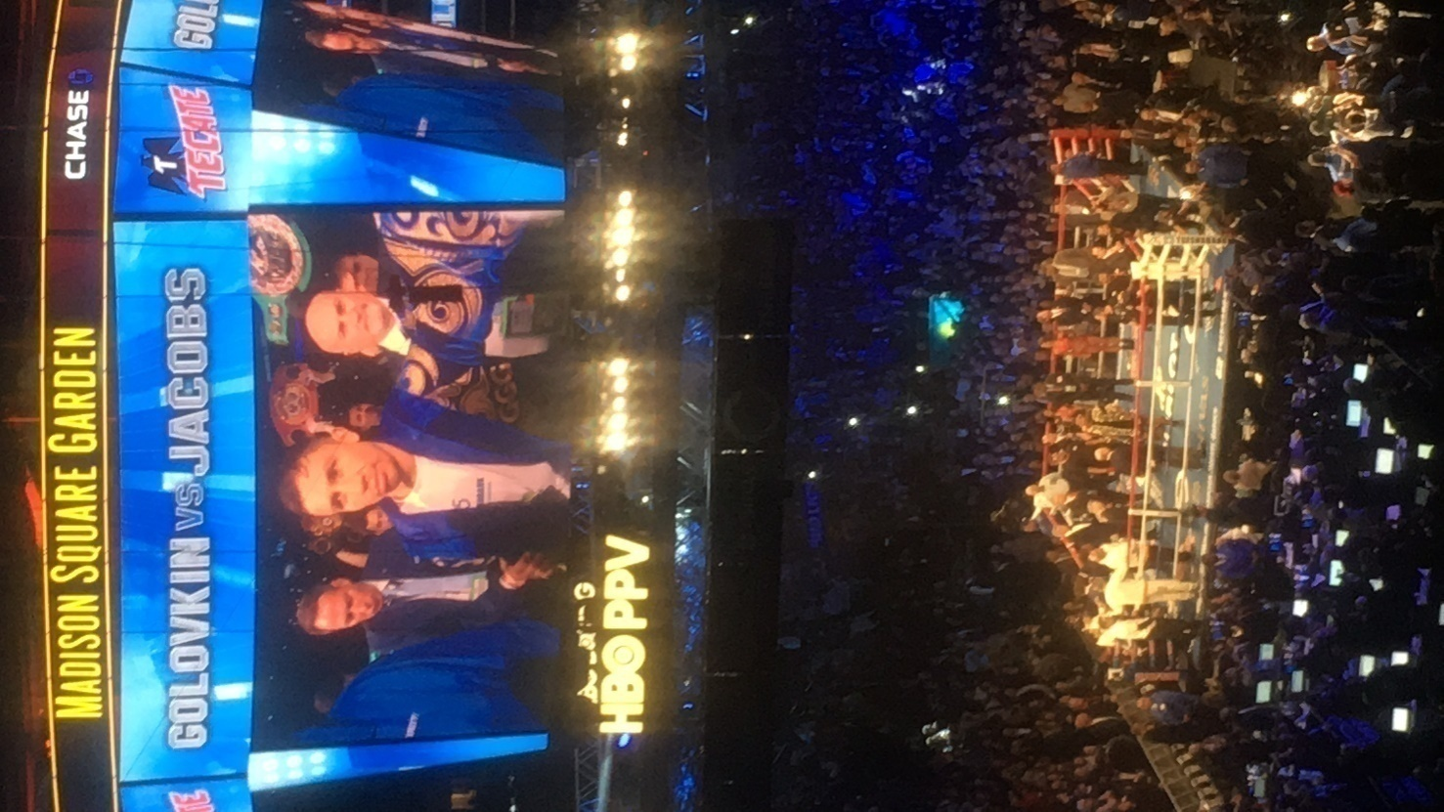
Follow every event in Madison Square Garden, you will definetly find something of your taste.

Slide 14
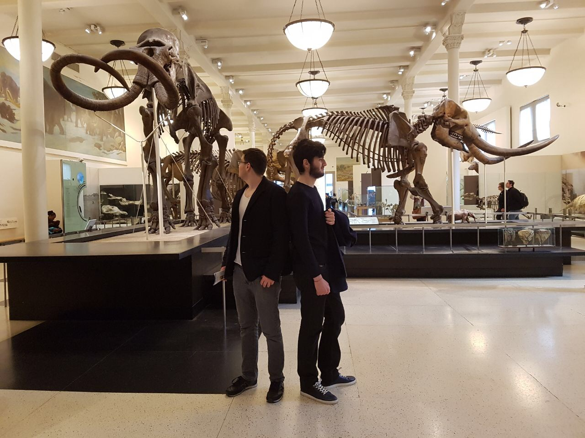
Visit some museums, big bro Bora will help you with that.

Slide 15
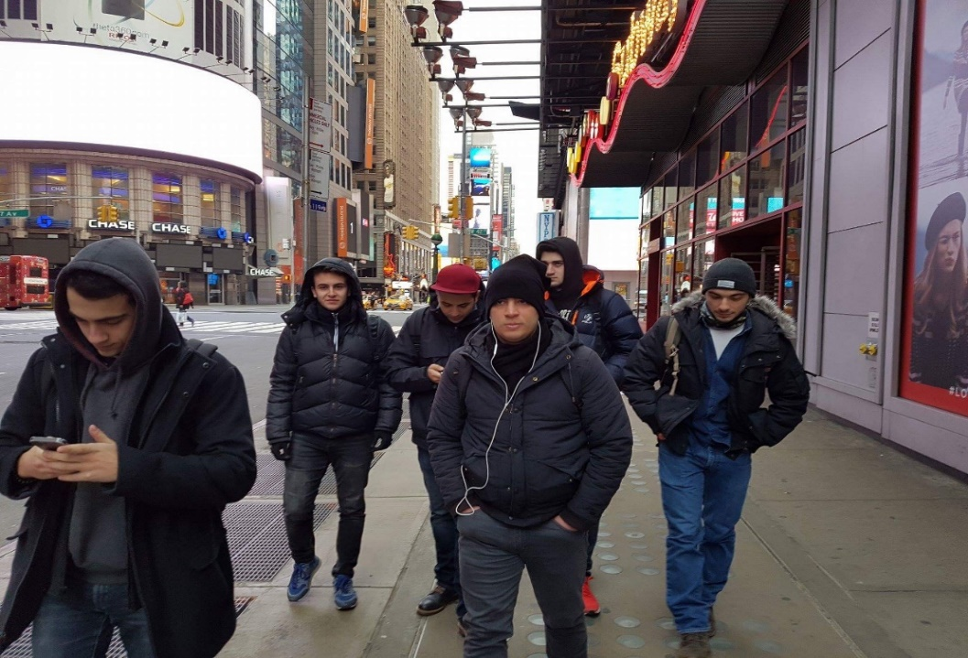
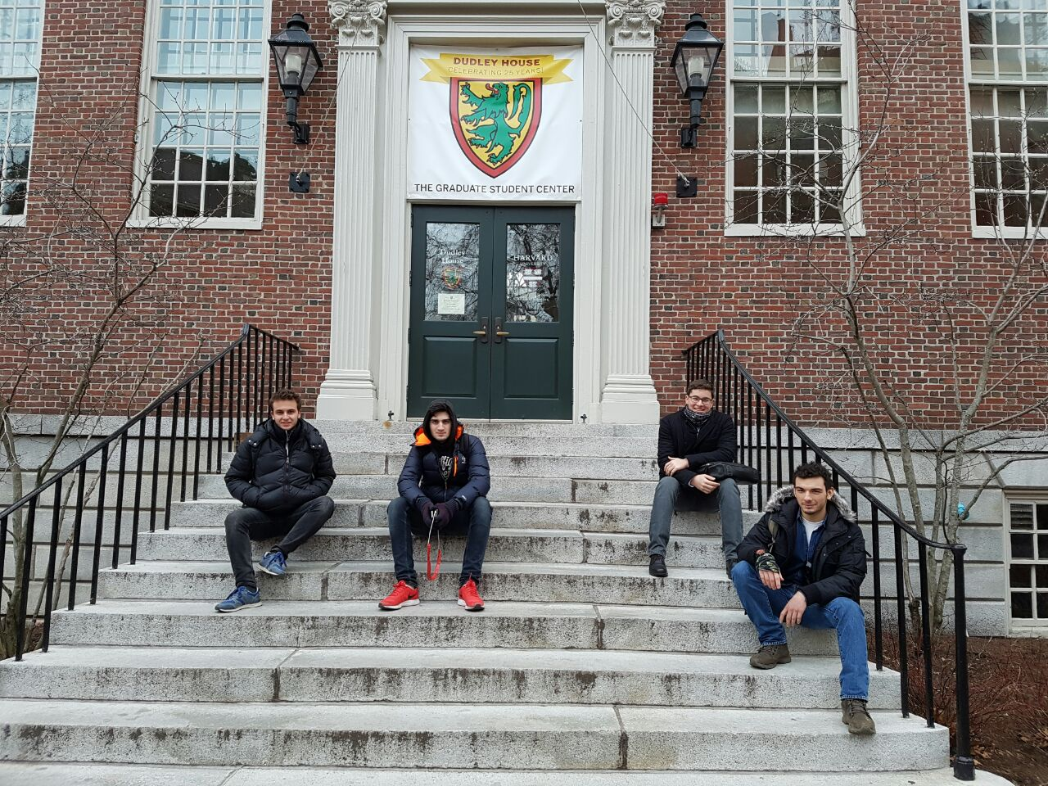
You should visit other cities too.Boston was quite fun with our big bro’s.
However Maritime is much better than Harvard.

